Slide 1



LAPTOP PRICE PREDICTION

Slide 2


members
Raja Kumar (E23MCAG0030)
Vikas Yadav (E23MCAG0066)
Utkarsh (E23MCAG0137)

Slide 3

2. Problem statement
Introduction
Data exploration
Feature Selection
Model selection
Model evaluation
User interface
Conclusion

Slide 4
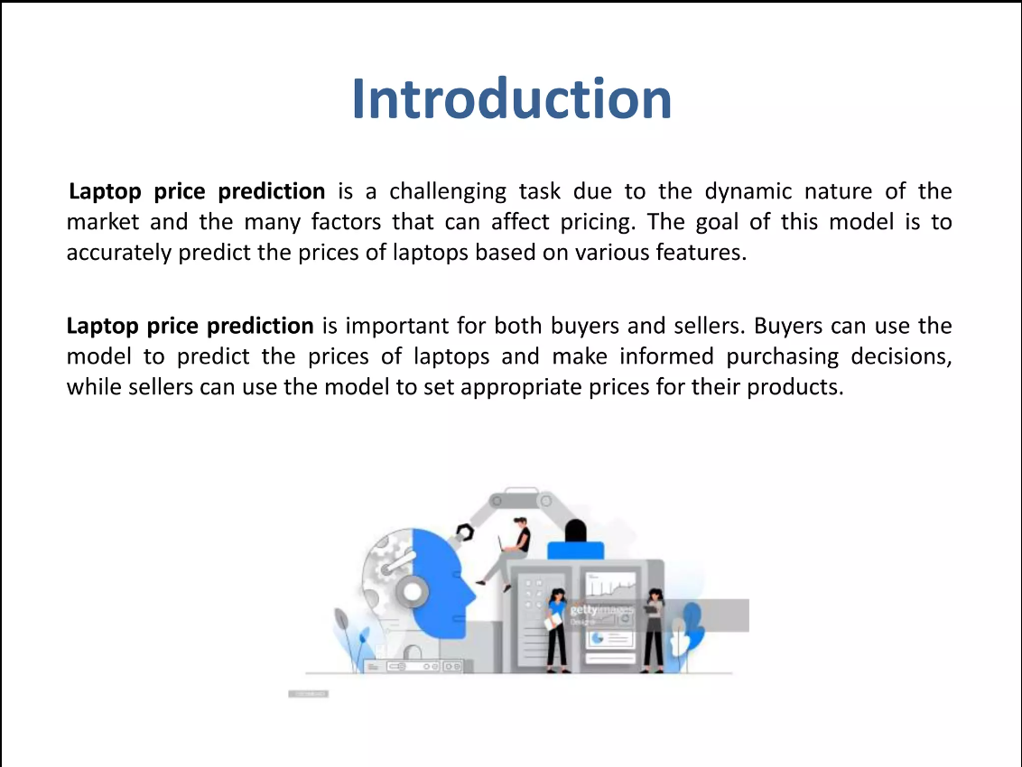

Slide 5


Slide 6
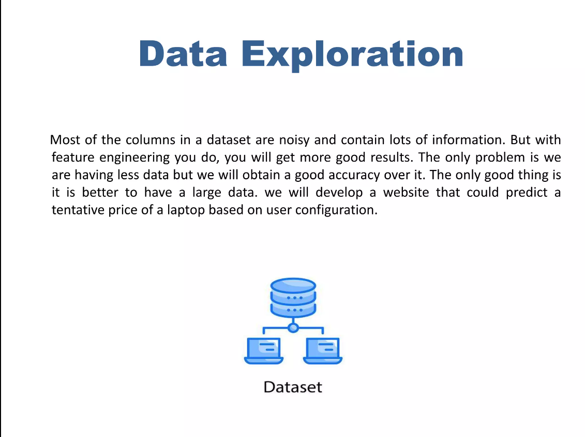

Slide 8
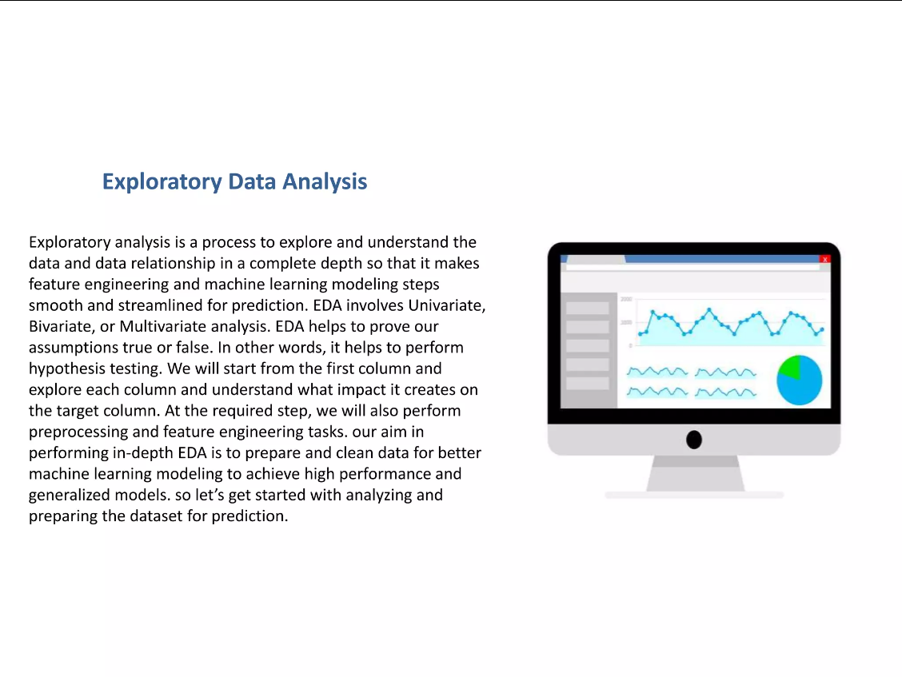

Slide 9
Dataset

Slide 10
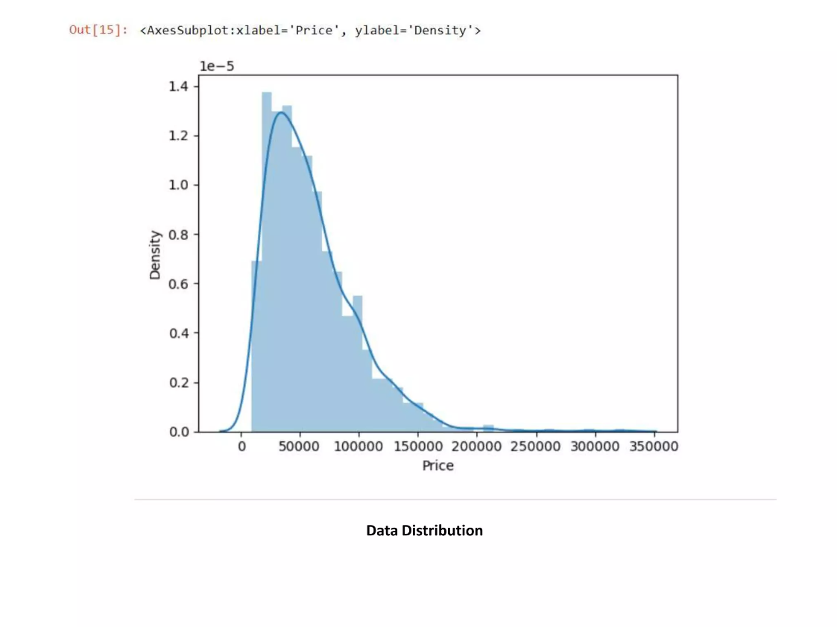
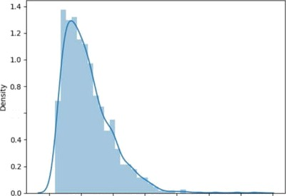
0.6
0
TO 00 100000 łß000 0 200ß00 2 ß0000 H0 000 350000
Data Distribution

Slide 11
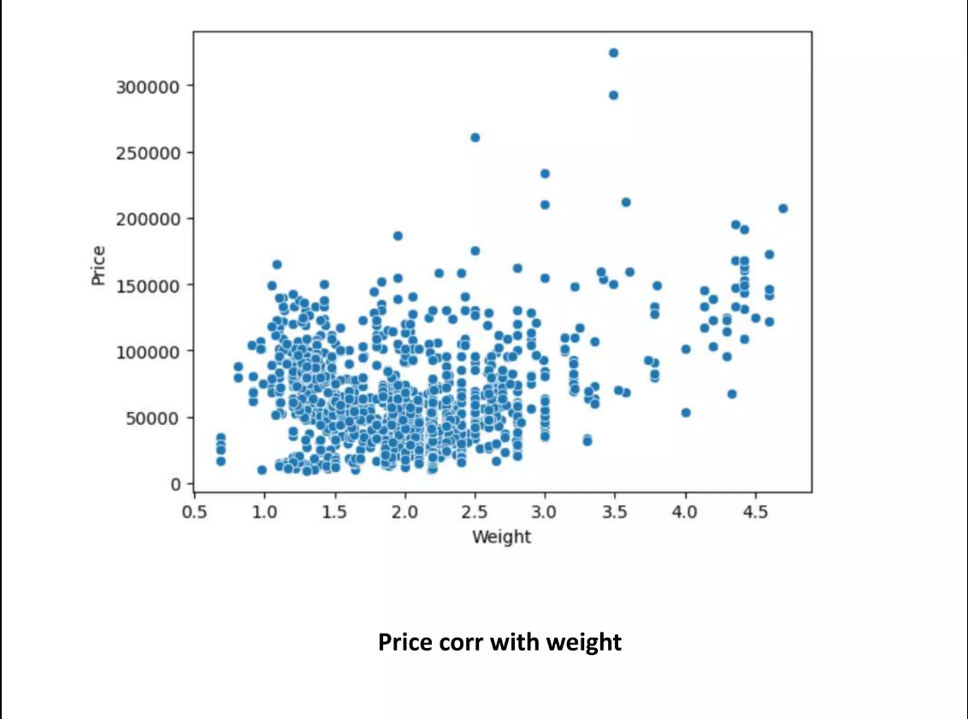







ß5
LO
LS
2.0
2.5
3.0
*s
^.0
4.5

Slide 12
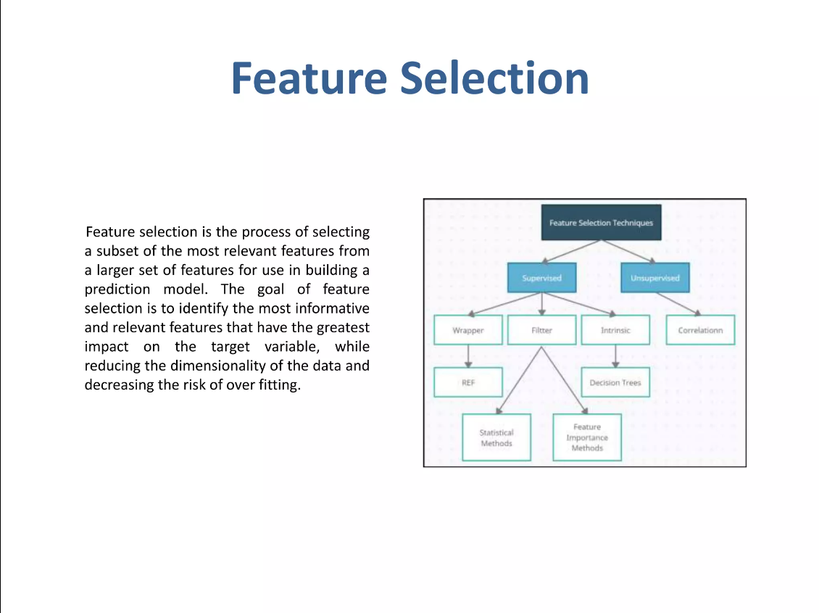
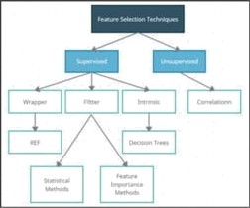
Feature Selection
Feature selection Is be process of selecting a subset of the most relevant features from a larger set of features for use in buiTdiog a
selection Ts to identlfy the most Informatlve and relevant features that have the greatest Impact on the target variable, while reduUng the dlmenxlonallty of the data and decreasing the risk of over fitrlng.

Slide 13
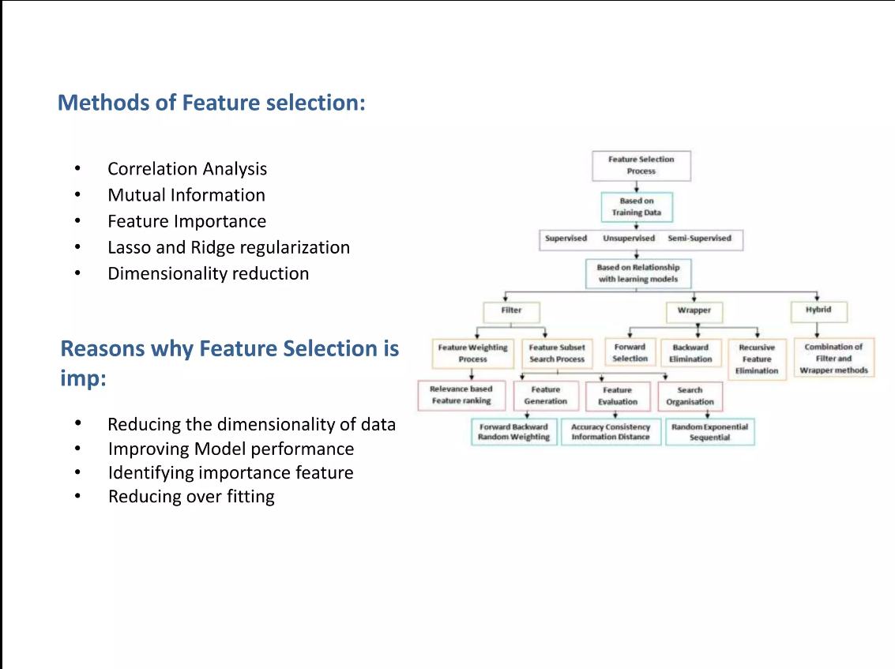

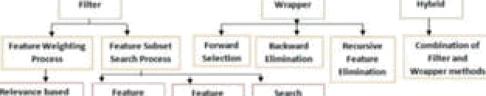

Methods of feature selection:
Correlation Analysis
Mutual Information
Feature Importance
Lasso and Ridge regularization
D{mensionallty reduction
”
Reasons why Feature Selection is Imp:
Reducing the dTmensionallty of dala
Improving Model performance
Identifying impartance feature
Reducing over fitting

Slide 14
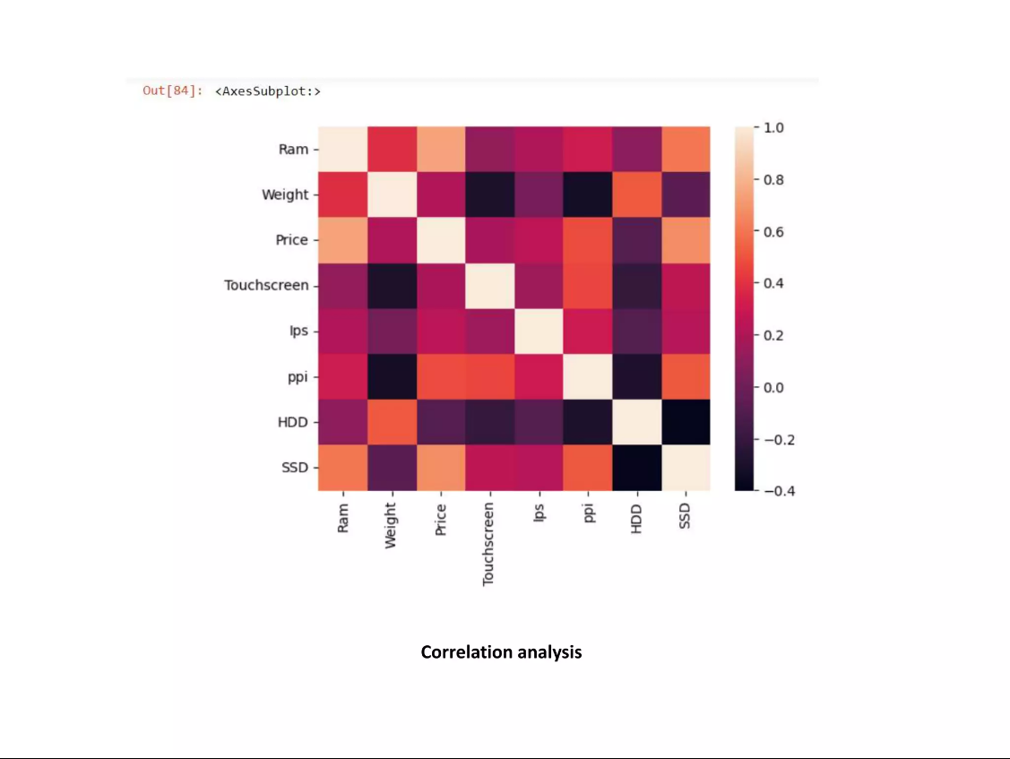
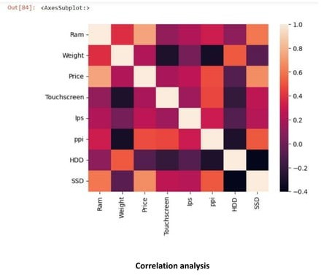

Slide 15
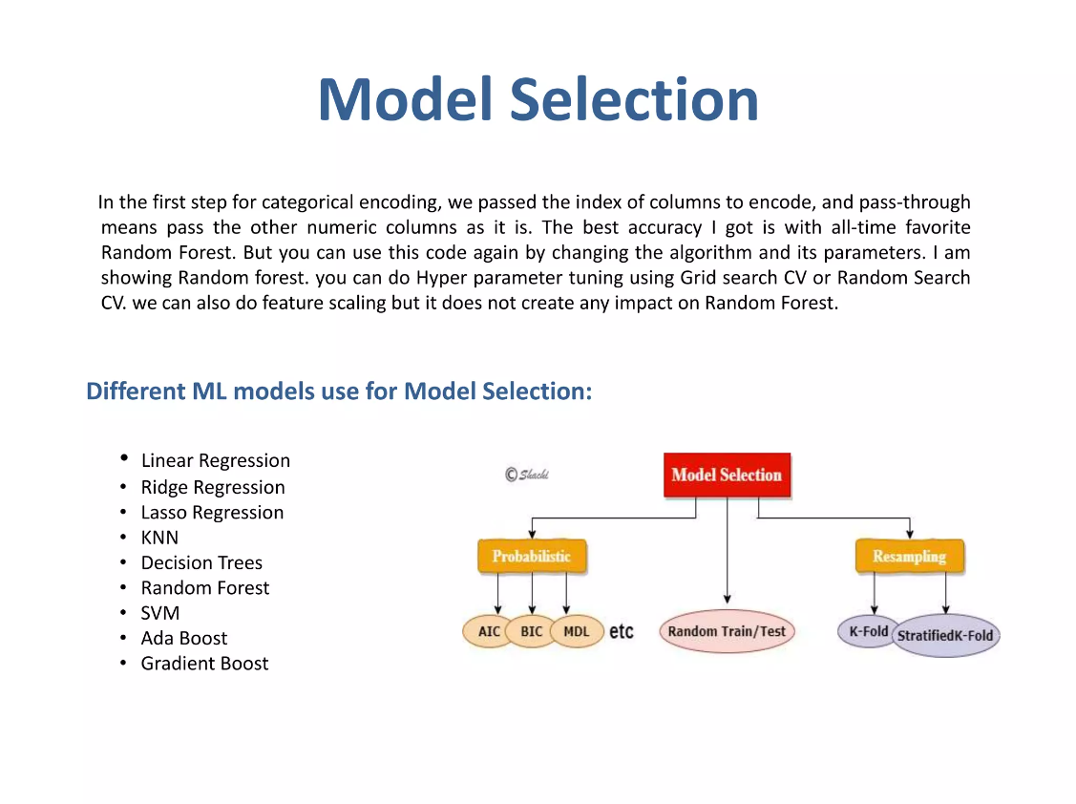
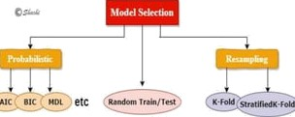
Model Selection
In the First step for categorlcal enœdl we passed the IodeX of œ!uÑns to encode, and pass-thF gh means pass the numeric'columns as it is. The best accuracy I got ls wlth all-dme favorite Ràndom Forest. But you can use this code again by changing the algorithm and il parameters. Tam showing Randorfii nrest. you can do Hyper parametër tunlng uslng Grid se'arch CV or Randorn Search CV. we can aTSo do feature scaJing but lt does not create any impact on Random Forest.
Diflerent ML models use for Model Selection:
Ridge 8egresslon
Decision TP
Random Forest
Ada Boost
Gradient eoost

Slide 16
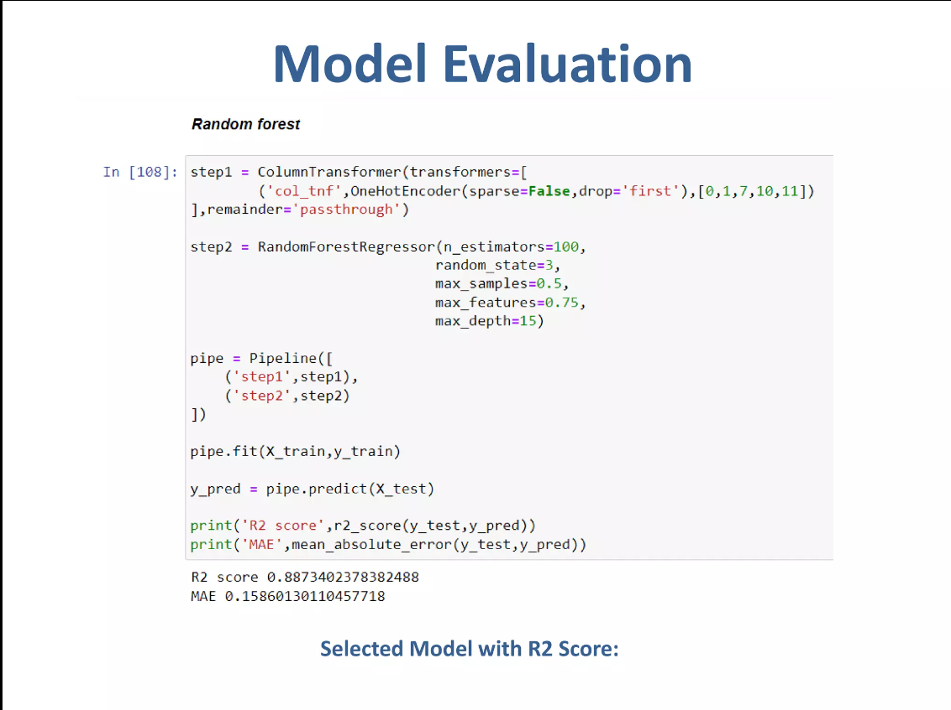
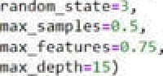
Model Evaluation
{ ” s Sep y ’ , ute p3} , ” s t ep 2 ’ , ute p2)
Selected Model with R2 Score:

Slide 17
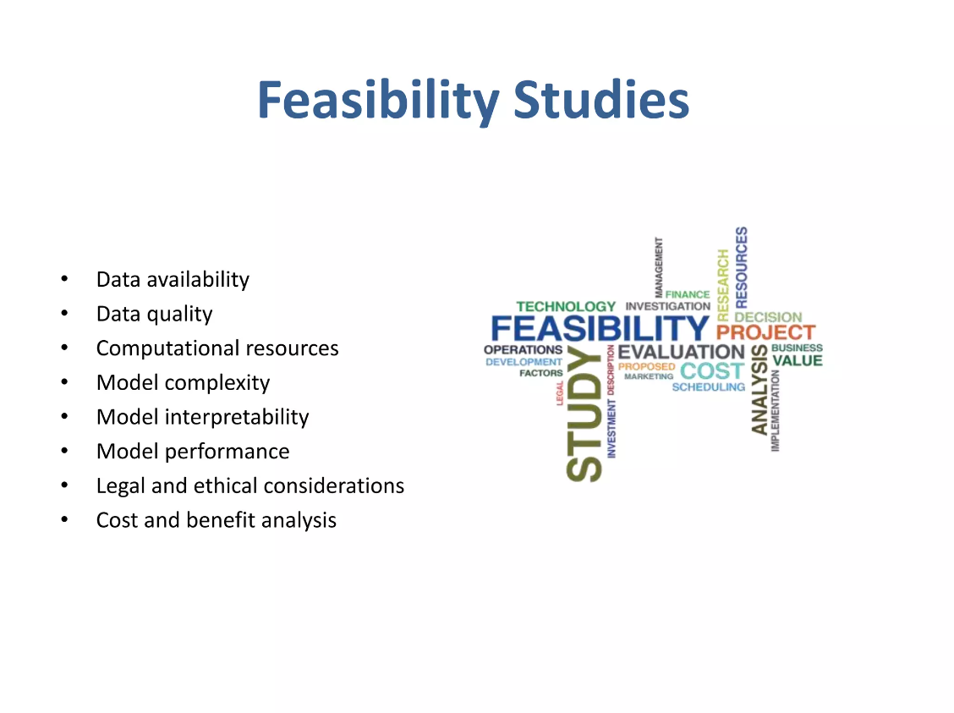
Feasibility Studies
Data availability
Data quality
° Computational resources
° Model complexity
° Model interpretability
° Model performance
° Legal and ethlcaI considerations
° Cost and benefit analysis
HMOLOG Y
FEASIBILITY PROJECT
EVALUATION
VVUE
COST

Slide 18
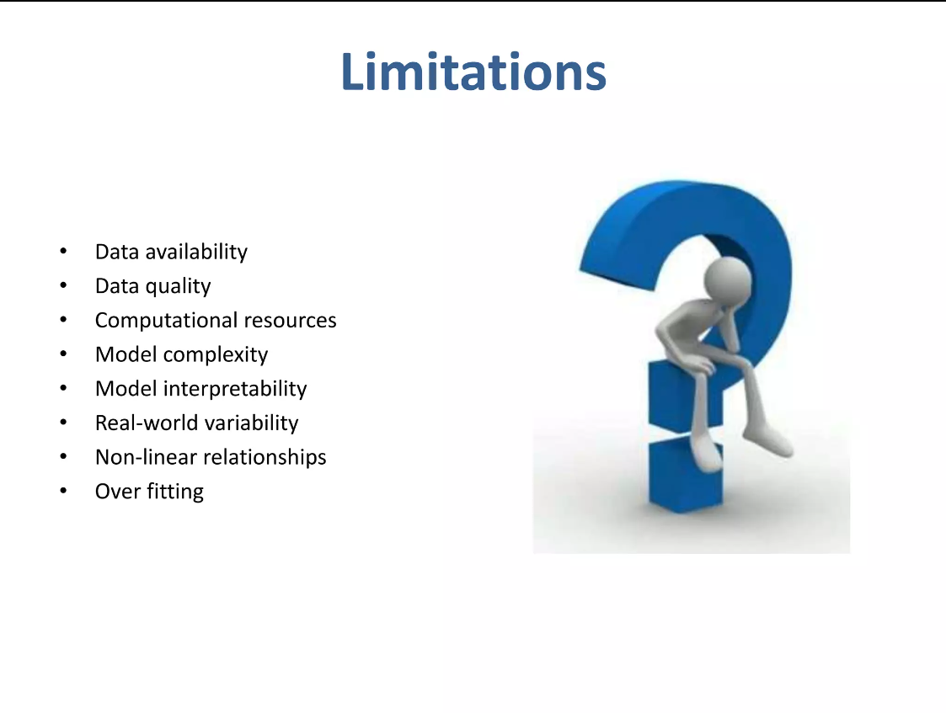

Limitations
Data availability
Data quality
° Computational resources
Model complexity
° Model interpretability
Real-world variability
° Non-linear relationships
° Over fitting

Slide 19
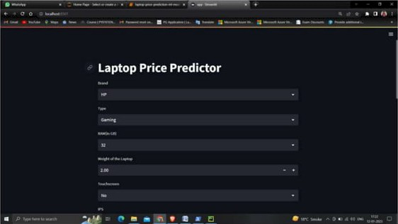
User Interface

Slide 20
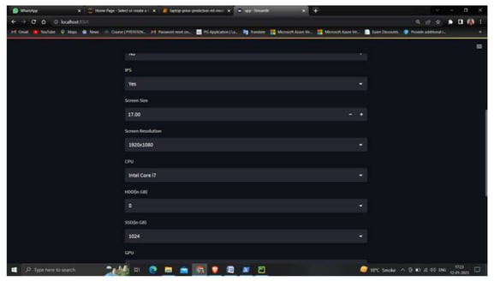

Slide 21
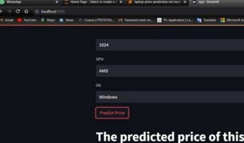
confi8uration is: rant3srs
- '• "
<› i t
•

Slide 22
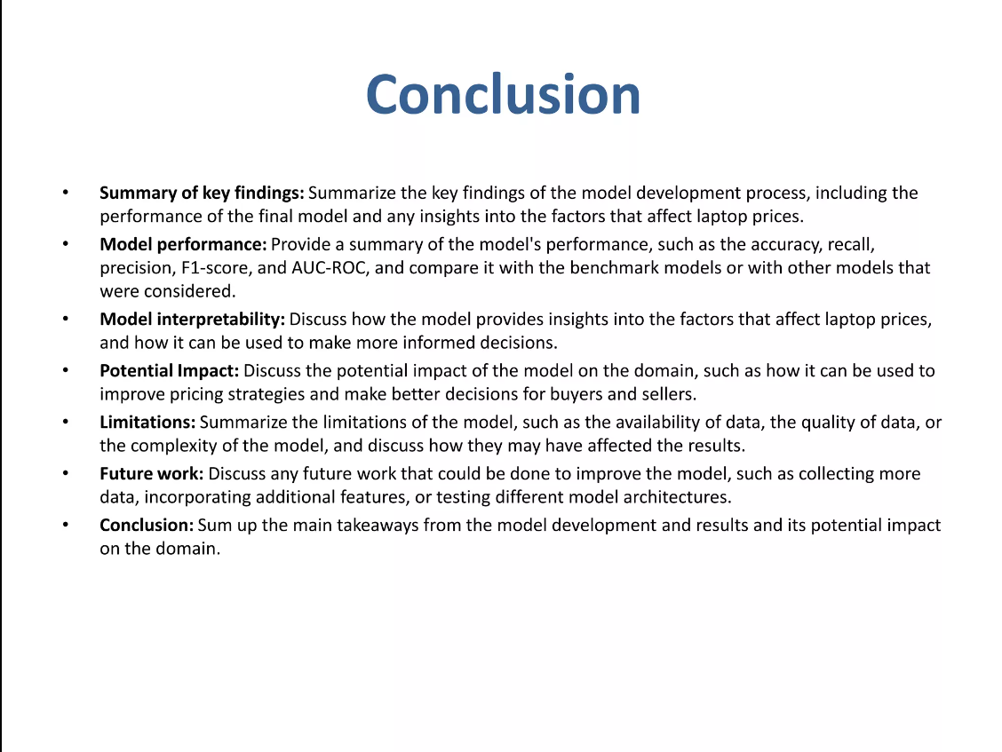
Conclusion
Summary of key findings: Svmmarlze the key flnąin8s of the model development process. lnduding the
performance of the final model and any insights Imo the factors that affecț Tapțop pflœs.
HødeT pazføzzzsanaa: Provide a summary of be model's performanœ, soch as the accuracy, recall, precision, F1•score, and SLIC-ROC, and œmpare it with the benchmark models or with other models that were considered.
hłedel Intergretabllity:discuss how the model provides insights into the factors that alTect laptop prices, and how it œn be used to mad more informed decisions.
Potential Impact: Olscuss the potential Impact of the model on the domain, such as how It œn be used to Improve pricing strategies and make berter decisions for buyers and seJlers.
M-flattens: Summarl e the limitations of the model, such as the availabiTfty of data, the smaller of data, or
the œmplex of the model, and discuss how they msy have añected the resuTțs.
Fwtørø ark: Discuss arm future work that could be done to Improve the model, sUch as collecting more data, incorporating additional features, or testing dlffererrt model architectures.
ConcIuslon: Sum up the main takeaways from the model development and resula and Its potential impact on the domain.

Slide 23


